Slide 1

CSE7302- University Project
X-PhyDNow: An Explainable Physics-Enhanced Framework for Satellite-Based Rainfall Nowcasting
Batch Number: CDV_15
Under the Supervision of,
Guide: Ms. Meena kumari K S
Assistant Professor
School of Computer Science and Engineering
Presidency University
Guide: Mr. Bailappa Bhovi
Assistant Professor
School of Computer Science and Engineering
Presidency University
Roll Number | Student Name
20221CDV0043 | Nayana B N
20221CDV0045 | Tushar L G
Name of the Program: Devops
Name of the HoD: Dr. S Pravinth Raja
Name of the Program Project Coordinator: Dr. H M Manjula
Name of the School Project Coordinators: Dr. Sampath A K

Slide 2
Content
Problem Statement
Objectives
Background and Related work for title Selection
Analysis of Problem Statement
Flow Chart
Architecture
Algorithm
Innovation or Novel Contributions
Git-hub Link
Timeline of the Project
References

Slide 3
Problem Statement Number: 134
Organization: AICTE, Student Innovation: Disaster Management
Category : Software
Problem Description:
Accurate short term prediction (nowcasting) of high-impact rainfall events is critical for disaster mitigation, agriculture, and urban planning.
While deep learning models have improved rainfall prediction accuracy using satellite data, most existing approaches act as black boxes, providing little to no explanation of their predictions.
This lack of interpretability limits:
Trust by meteorologists
Operational adoption
Understanding of model failure cases

Slide 4
Problem Statement Number: 134
Problem Defination:
High-impact rainfall events cause severe consequences such as floods, landslides, infrastructure damage, and loss of life. Accurate short term rainfall nowcasting (0 to 6 hours) is critical for disaster preparedness and early warning systems.
Core Issue:
Traditional Numerical Weather Prediction (NWP) models:
Are computationally expensive
Perform poorly at short lead times
Deep learning models:
Improve prediction accuracy
Act as black boxes, offering no scientific explanation
Identified Gap:
There is a lack of trustworthy, explainable, and physics-aware AI systems for satellite-based rainfall nowcasting.

Slide 5
Problem Statement Number: 134
Why This Problem Matters:
India experiences frequent extreme rainfall events, especially during monsoon seasons
Timely and reliable nowcasting can:
Reduce disaster response time
Support decision-making by meteorological agencies
Improve public safety alerts
Target Users:
Meteorological agencies
Disaster management authorities
Researchers in AI and Earth observation
General Public

Slide 6
Objectives
Primary Objectives
To design an AI-based system for short-term rainfall nowcasting using satellite data
To integrate Explainable AI (XAI) and Physical Dynamics network for transparent model decision interpretation
Specific Measurable Objectives
Predict rainfall intensity and probability at 30-minute resolution
Identify key spatiotemporal drivers influencing predictions
Separate physics-guided dynamics from data-driven residual learning
Analyze and explain model failure cases
Ensure reproducibility through structured code and data pipelines

Slide 7
Background and Related work
Background:Domain Overview
Satellite Based Rainfall Nowcasting
Uses geostationary satellites for continuous Earth observation
Key satellite indicators:
Infrared brightness temperature (cloud top height)
Water vapour distribution
Cloud evolution patterns
AI in Weather Prediction
CNNs and ConvLSTMs capture spatial temporal patterns
Recent shift toward physics-guided deep learning
Growing demand for explainable AI in safety critical systems

Slide 8
Background and Related work
Related work:
Existing Approaches
ConvLSTM based rainfall nowcasting
Physics-inspired deep networks for cloudbust
Attention-based spatiotemporal models
Post-hoc explainability methods (Grad CAM, SHAP)
Limitations in Existing Work
Limited interpretability
No separation of physical vs learned behavior
Explanations often qualitative, not scientifically validated
Rare focus on failure explanation

Slide 9
Analysis of Problem Statement
Key Challenges
Highly nonlinear and localized rainfall patterns
Data imbalance (extreme events are rare)
Temporal misalignment between datasets
Lack of interpretability in deep models
Constraints
Satellite-only inputs (no radar dependency)
Limited labeled extreme rainfall samples
Need for computational efficiency
Research Gaps
No branch level interpretability in physics guided networks
No quantitative validation of explanation relevance
Minimal study of why models fail

Slide 10
Analysis of Problem Statement
Primary Datasets:
GPM IMERG: Ground-truth rainfall (30-min, 0.1°)
INSAT-3D / 3DR: Satellite imagery (IR, WV)
Supporting Datasets:
ERA5 Reanalysis: CAPE, moisture (for explainability validation)
IMD Gridded Rainfall: Independent verification
Software Requirements:
Operating System: Windows 10 / Windows 11
Development Environment: PyCharm IDE
Programming Language: Python 3.9+
Justification:
Dominant language in AI and geospatial research
Extensive scientific computing ecosystem
Supported by NASA, ECMWF, and ISRO data formats

Slide 11
Analysis of Problem Statement
Hardware Requirements :
CPU: Intel i5 / Ryzen 5 or higher
RAM: 16 GB
Storage: 100+ GB (satellite data intensive)
Libraries :
Core AI & ML Libraries
PyTorch
Torchvision
Data Handling
NumPy-numerical computation
Pandas-metadata and tabular processing
xarray-multidimensional geospatial data
h5py-HDF5 satellite data access
netCDF4-ERA5 data handling
Visualization
Matplotlib and Cartopy(geospatial plotting)

Slide 12
Analysis of Problem Statement
Baseline Algorithm: ConvLSTM
ConvLSTM (Convolutional Long Short-Term Memory) combines convolutional layers with recurrent LSTM units to model spatiotemporal sequences. It is widely used in rainfall nowcasting to learn the evolution of precipitation patterns from historical observations.
Why ConvLSTM is Chosen as Baseline:
Spatial feature learning: CNN kernels capture spatial rainfall structures
Temporal dependency modeling: LSTM gates model time evolution
Literature acceptance: Frequently used benchmark in satellite- and radar-based nowcasting studies
Implementation simplicity: Provides a stable reference for performance comparison
Limitations of ConvLSTM:
Entirely data-driven, with no physical constraints
Learns correlations but not atmospheric dynamics
Acts as a black box with limited interpretability
Prone to unrealistic predictions under rare/extreme events

Slide 13
Analysis of Problem Statement
Proposed Algorithm: X-PhyDNow (Explainable Physics-Guided Network)
Core Architectural Idea
X-PhyDNow extends spatiotemporal deep learning by explicitly separating physical dynamics from residual learning, enabling both improved accuracy and interpretability.
Key Components:
CNN Encoder: Extracts spatial features from satellite imagery
Physics-Guided Branch: Learns smooth, physically plausible evolution (advection–diffusion–like behavior)
Residual Branch: Captures fast, nonlinear convective variations
Feature Fusion Layer: Integrates physical and residual representations
Prediction Head: Outputs rainfall intensity / probability maps
Why Physics-Guided Learning:
Aligns learning with known atmospheric behavior
Improves generalization under unseen conditions
Reduces physically implausible rainfall predictions

Slide 14
Analysis of Problem Statement
Explainable AI (XAI) Strategy
Explainability Technique
Integrated Gradients (IG)
Axiomatic attribution method
Computes pixel-wise contribution of inputs to predictions
Suitable for deep neural networks and satellite imagery
Branch-Wise Explainability (Key Innovation)
Separate attribution analysis for:
Physics-Guided Branch
Residual (Data-Driven) Branch
Enables understanding of:
Whether predictions are driven by physical structure
Or by purely learned patterns
Failure Analysis
Contrastive explanations used to analyze:
False positives (false rainfall alarms)
Missed high-impact rainfall events

Slide 15
Analysis of Problem Statement
Physical Consistency Analysis
Physical Consistency Score (PCS)
Purpose
To quantitatively evaluate whether AI explanations align with known meteorological principles
Moves explainability beyond visual heatmaps to scientific validation
Validation Parameters
CAPE: Measures atmospheric instability
Precipitable Water Vapour (PWV): Indicates moisture availability
Cloud-Top Temperature Trends: Proxy for deep convection
Outcome
Ensures explanations are meteorologically meaningful
Improves trustworthiness of AI predictions
Bridges the gap between deep learning and atmospheric science

Slide 16
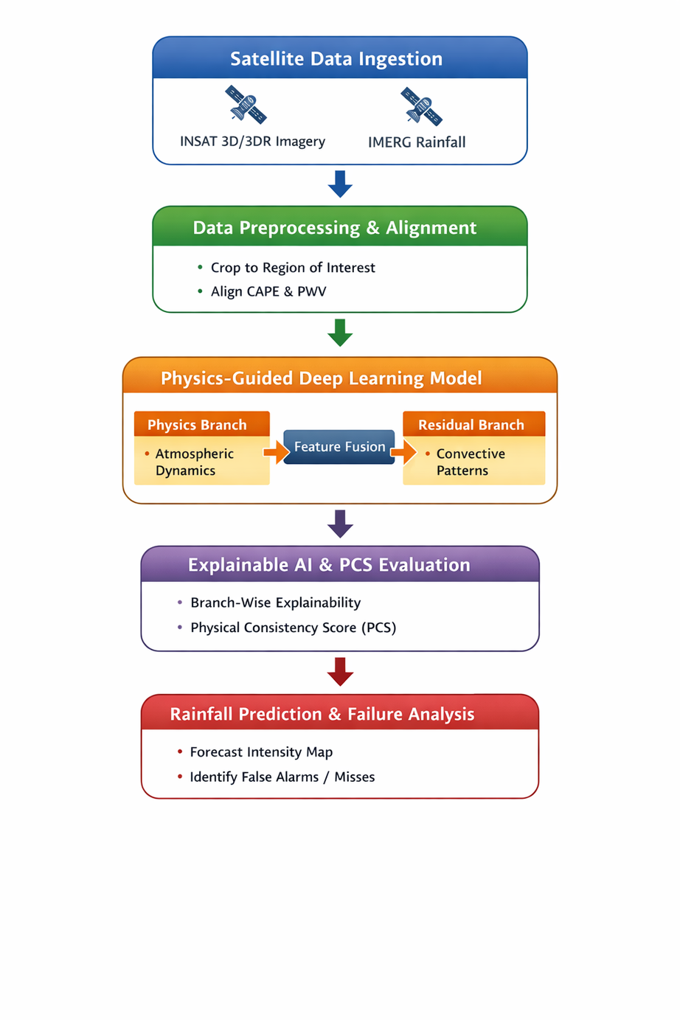
Flow Chart
This framework integrates satellite imagery (INSAT 3D/3DR) and IMERG rainfall data with atmospheric parameters (CAPE, PWV) for physics-aware forecasting.
Preprocessing: Region cropping and spatial-temporal alignment of meteorological variables.
Physics-Guided Model: Dual-branch architecture combining atmospheric dynamics (physics branch) and convective patterns (residual branch) through feature fusion.
Explainable AI: Branch-wise interpretability and Physical Consistency Score (PCS) ensure scientifically reliable predictions.
Output: Rainfall intensity maps with failure analysis (false alarms and misses).
Key Insight: Combines deep learning with atmospheric physics for robust and interpretable rainfall forecasting.

Slide 17
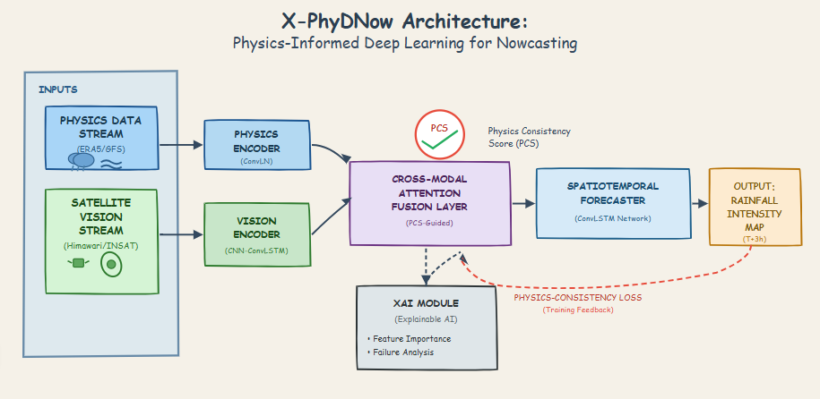
Architecture Diagram
Inputs:
Physics data (ERA5/GFS weather models)
Satellite imagery (Himawari)
Processing:
Two separate encoders process physics and vision data
Cross-modal attention fusion combines both data streams
Physics Consistency Score (PCS) guides the fusion process
Spatiotemporal forecaster generates predictions using ConvLSTM
Output:
Rainfall intensity map for 3 hours ahead (T+3h)
Key Features:
Physics-consistency loss provides training feedback to improve accuracy
XAI module offers explainability through feature importance and failure analysis
Combines traditional physics models with satellite observations for better nowcasting

Slide 18
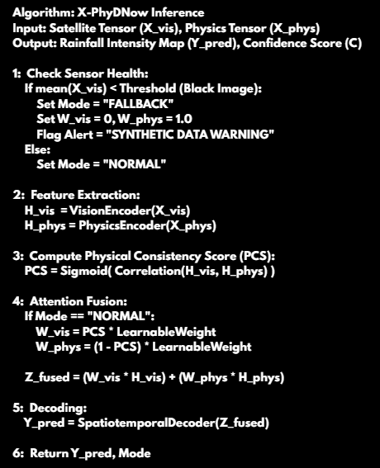
Algorithm
This algorithm predicts rainfall intensity by combining satellite visual data and physics-based meteorological data.
Sensor Health Check: Detects faulty/black satellite images and switches to a fallback physics-only mode if needed.
Feature Extraction: Uses separate encoders to extract high-level representations from visual and physical inputs.
Physical Consistency Score (PCS): Measures correlation between visual and physics features to ensure physically meaningful predictions.
Attention Fusion: Dynamically weights visual and physics features based on PCS for robust data fusion.
Spatiotemporal Decoding: Generates the final rainfall intensity map.
Key Advantage: Adaptive, physics-aware fusion improves reliability and handles sensor failure gracefully.

Slide 19
Innovation or Novel Contributions
Branch-Wise Explainability (Structural Interpretability):
Unlike conventional explainable AI approaches that treat the model as a single black box, this project introduces branch wise explainability by design.
Key Idea:
The deep learning model is explicitly divided into:
A Physics-Guided Branch (models smooth, physically plausible atmospheric evolution)
A Residual Data-Driven Branch (models fast, nonlinear convective variability)
Explainability is applied separately to each branch.
Why this is novel
Existing works apply XAI after prediction, without understanding which part of the model caused the decision.
This approach reveals:
Whether predictions are driven by physical dynamics
Or dominated by purely learned residual patterns
Impact
Enables model trust diagnosis
Helps meteorologists decide when to rely on AI predictions

Slide 20
Innovation or Novel Contributions
Physical Consistency Score (PCS):
This project introduces a quantitative metric to validate whether AI explanations are physically meaningful.
Key Idea
XAI heatmaps are compared against known meteorological indicators:
Atmospheric instability (CAPE)
Moisture availability (Precipitable Water Vapour)
Cloud-top temperature trends
The degree of spatial and temporal alignment is measured as the Physical Consistency Score (PCS).
Why this is novel
Most XAI methods rely on visual plausibility
PCS transforms explainability into a measurable scientific validation
Impact
Moves explainable AI from subjective interpretation to objective evaluation
Strengthens scientific credibility of AI-based weather prediction

Slide 21
Innovation or Novel Contributions
Explainable Failure Analysis:
Instead of explaining only correct predictions, this project explicitly analyzes model failures.
Key Idea
Contrastive explanations are used to study:
False alarms (predicted rainfall that did not occur)
Missed events (actual rainfall not predicted)
The model identifies which missing or weak physical signals led to failure.
Why this is novel
Most studies focus solely on improving accuracy
Very few investigate why AI systems fail in extreme weather scenarios
Impact
Provides actionable insights for model improvement
Increases reliability in safety-critical forecasting applications

Slide 22
Innovation or Novel Contributions
INSAT-Focused, Region-Specific Framework:
The proposed framework is specifically designed for INSAT-3D / INSAT-3DR satellite data and Indian monsoon dynamics.
Key Idea
Uses INSAT’s geostationary observations:
Infrared (IR)
Water Vapour (WV)
Tailors preprocessing, thresholds, and evaluation to Indian climatic conditions.
Why this is novel
Most advanced rainfall nowcasting studies focus on:
GOES (USA)
Himawari (Japan)
INSAT remains under-explored in explainable AI literature.
Impact
Regionally relevant and operationally meaningful
Supports indigenous satellite utilization and local disaster management needs

Slide 23
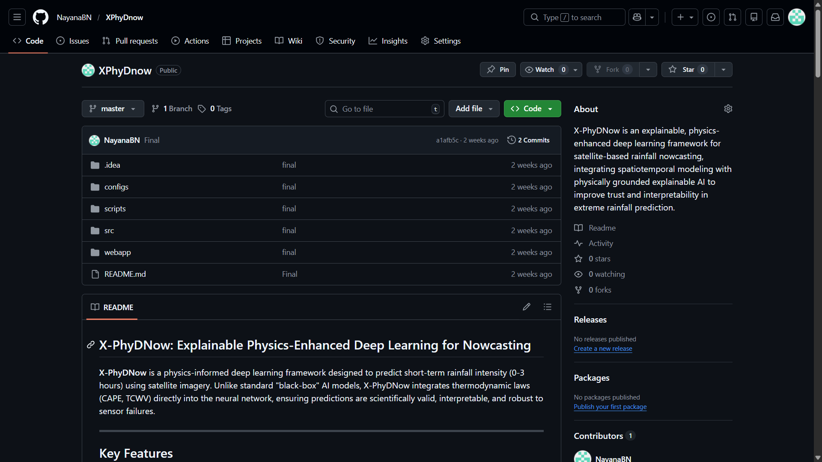
Github Link
The Github link provided should have public access permission.
https://github.com/NayanaBN/XPhyDnow

Slide 24
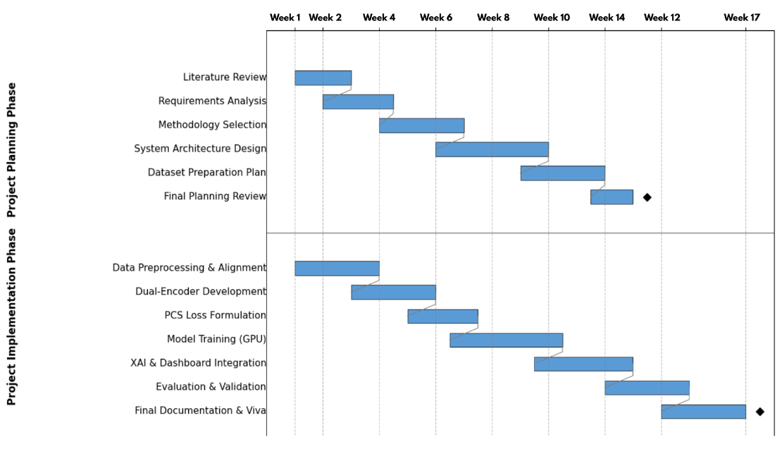
Timeline of the Project (Gantt Chart)

Slide 25
References
IEEE Journal Papers:
J. Yuan et al., "A Physics-Enhanced Network for Predicting Sequential Satellite Images of Typhoon Clouds," in IEEE Journal of Selected Topics in Applied Earth Observations and Remote Sensing, vol. 18, pp. 16798-16815, 2025, doi: 10.1109/JSTARS.2025.3574201.
M. Abdullah, S. Waheed, M. Mahmodul Hasan and M. Morshed, "Explainable AI-Driven Dew Point Forecasting With Attention-Based Temporal Convolutional Networks," in IEEE Access, vol. 13, pp. 59923-59948, 2025, doi: 10.1109/ACCESS.2025.3557263.
A. Roy, K. D. Gaikwad, A. J. Hude, J. S. Shinde, J. Parekh and H. R. Nagrani, "Explainable AI (XAI) for Object Detection and Application to Satellite Imagery," in IEEE Access, vol. 13, pp. 185597-185623, 2025, doi: 10.1109/ACCESS.2025.3624198.
L. He et al., "Deep Learning-Based Feature Importance for Rainfall Nowcast Driven by GNSS PWV and CAPE," in IEEE Journal of Selected Topics in Applied Earth Observations and Remote Sensing, vol. 18, pp. 26688-26698, 2025, doi: 10.1109/JSTARS.2025.3621857.

Slide 26
References
Springer Journal Papers:
B. Lütjens et al., "Generating Physically-Consistent Satellite Imagery for Climate Visualizations," in IEEE Transactions on Geoscience and Remote Sensing, vol. 62, pp. 1-11, 2024, Art no. 4213311, doi: 10.1109/TGRS.2024.3493763.
Li, J., Zheng, J., Li, B. et al. Quantitative Applications of Weather Satellite Data for Nowcasting: Progress and Challenges. J Meteorol Res 38, 399–413 (2024). Li, J., Zheng, J., Li, B. et al. Quantitative Applications of Weather Satellite Data for Nowcasting: Progress and Challenges. J Meteorol Res 38, 399–413 (2024). Li, J., Zheng, J., Li, B. et al. Quantitative Applications of Weather Satellite Data for Nowcasting: Progress and Challenges. J Meteorol Res 38, 399–413 (2024). https://doi.org/10.1007/s13351-024-3138-6
Shukla, B.P., Vyas, J., Chhari, A. et al. Satellite based rainfall nowcasting using geospatial techniques. Meteorol Atmos Phys 137, 3 (2025). https://doi.org/10.1007/s00703-024-01049-5

